Slide 1
Generative Models
Instructor: Dr. Yan Yan

Slide 2


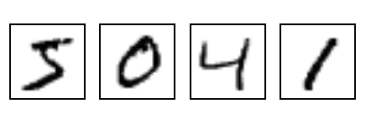
Generative Adversarial Network
NN
Generator
v1
NN
Generator
v2
NN
Generator
v3
Discriminator
v1
Discriminator
v2
Discriminator
v3
Real images:

Slide 3
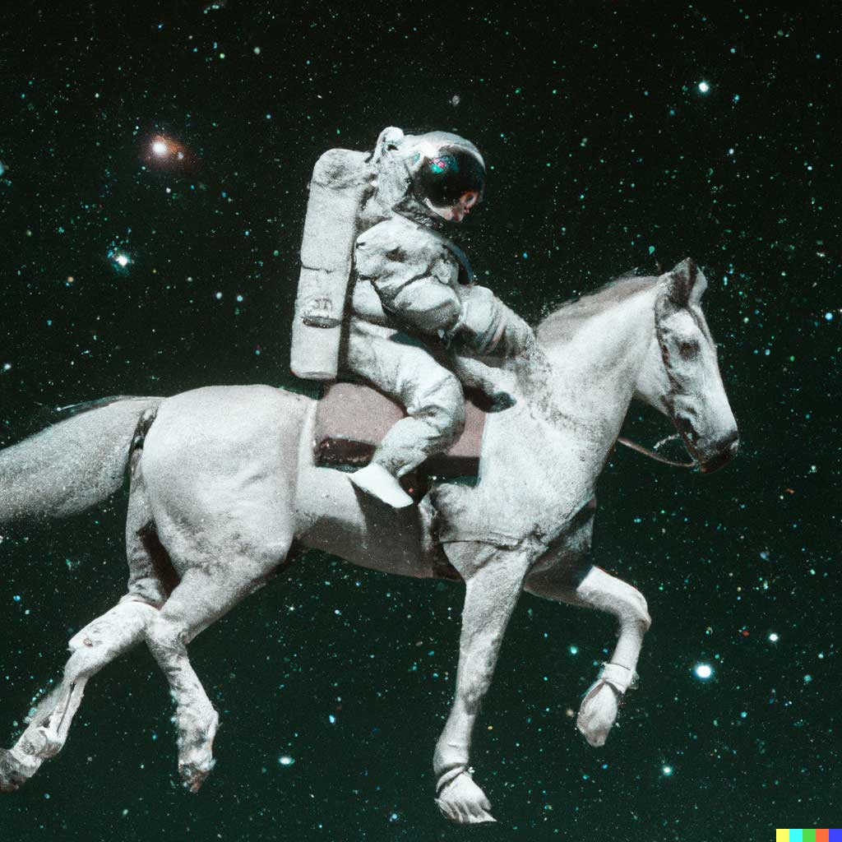
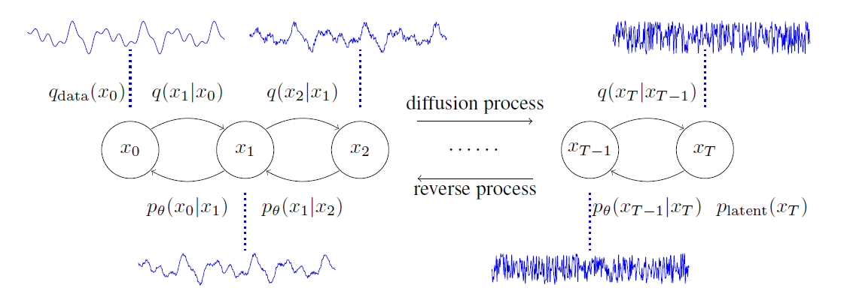
Diffusion Model
AI for generation
Superstar - diffusion models
Text Input: An astronaut riding a horse.
*Image from [ DALLE-2 22’]
*Figure from [ DiffWave ICLR20’]

